Slide 1
ANDROID MUSIC PLAYER
SUBMITTED BY:
19BCS1182 AMAN RAJ
19BCS1184 RISHABH KUMAR SINGH
SUBMITTED TO:
PALVI SHARMA

Slide 2
LIBRARIES
ROOM
COROUTINE SUPPORT FOR ROOM
VIEWMODEL AND LIFECYCLE EXTENSIONS
COROUTINE
RECYCLER VIEW
MEDIASTORE
MEDIAPLAYER
GESTUREDETECTOR

Slide 3
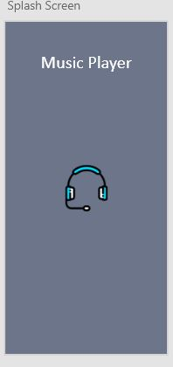
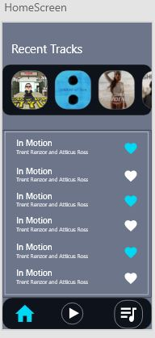
DESIGNS

Slide 4
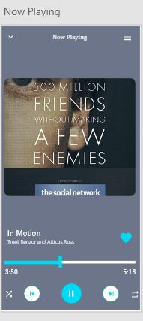
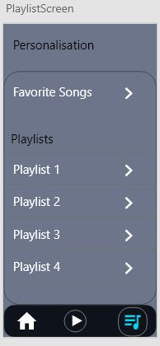

Slide 5
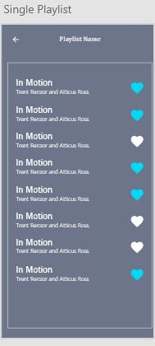

Slide 6
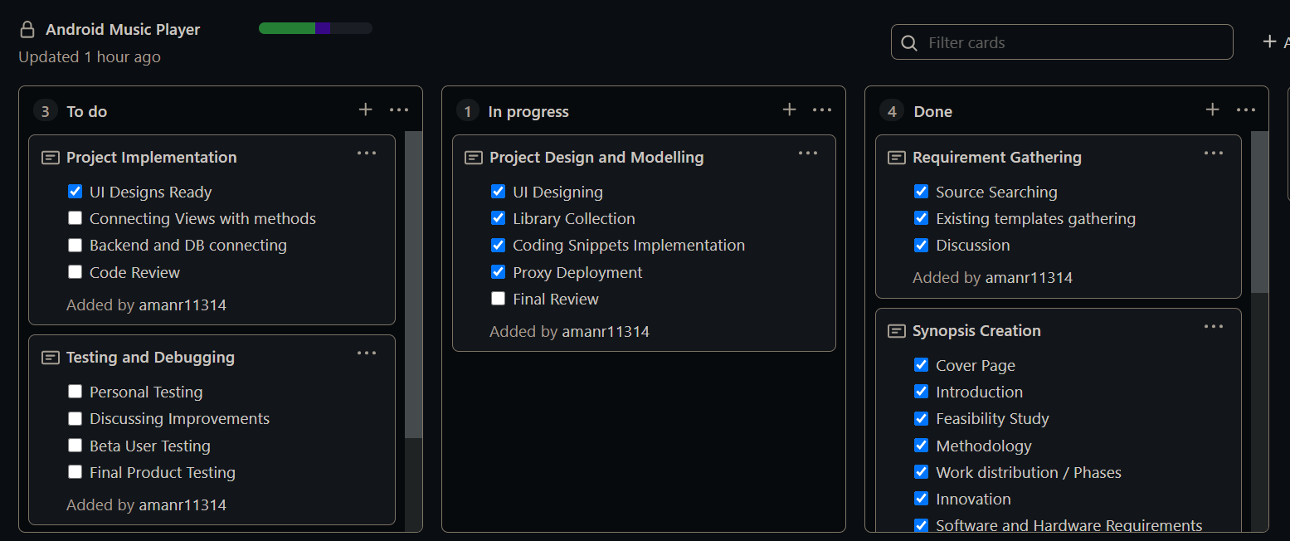
STATUS

Slide 7
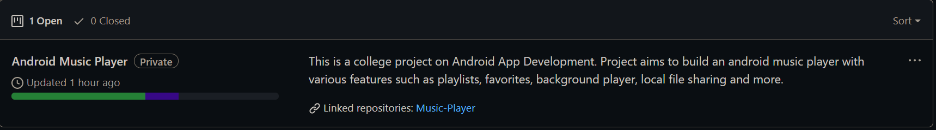
PROGRESS

Slide 8
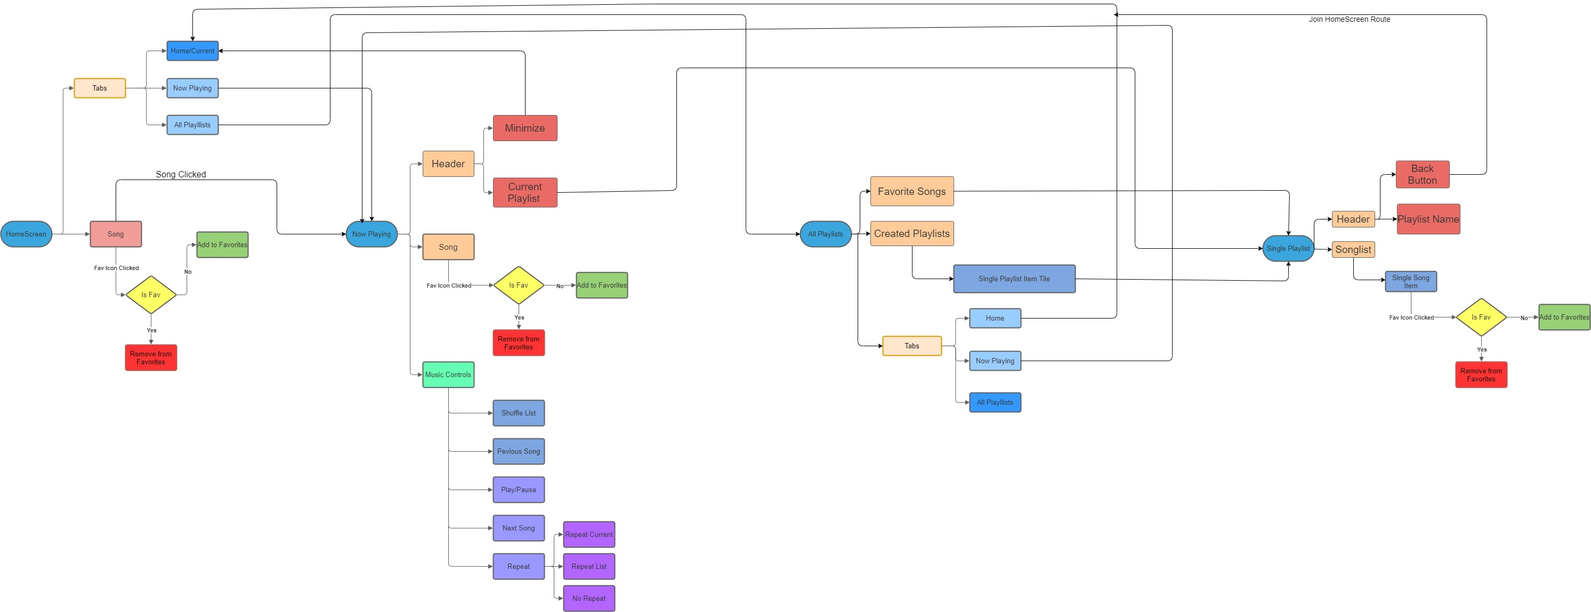
APP FLOW

Slide 9

LEVEL 0 DFD

Slide 10
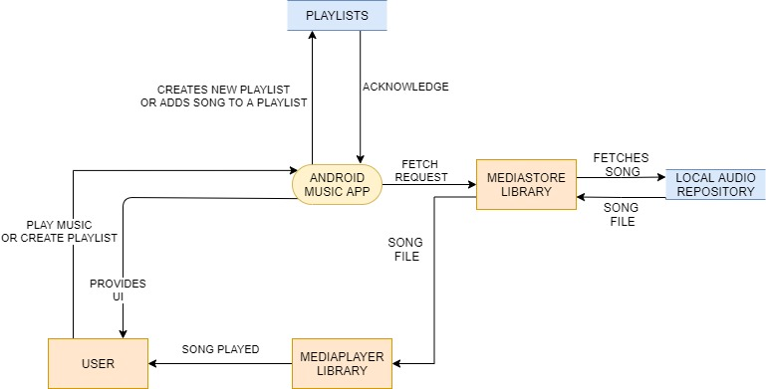
LEVEL 1 DFD

Slide 11
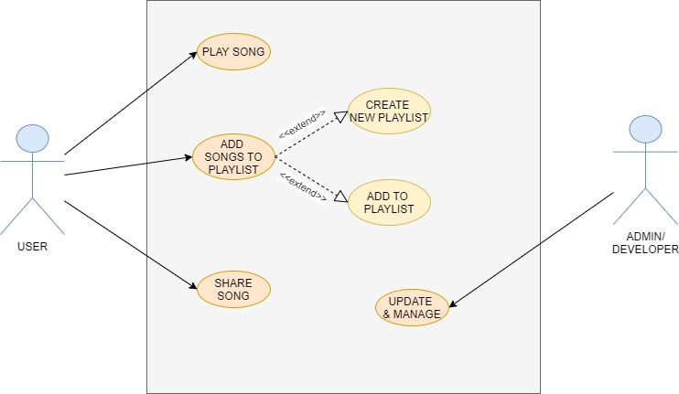
USE CASE DIAGRAM

Slide 12
COLOR THEME
#00d9f6 blue (Used in Icons )
#0e121b black (App theme - App bar,etc)
#6c7589 grey (Background of any activity)
#ffffff white (Used in all texts and symbols)

Slide 13
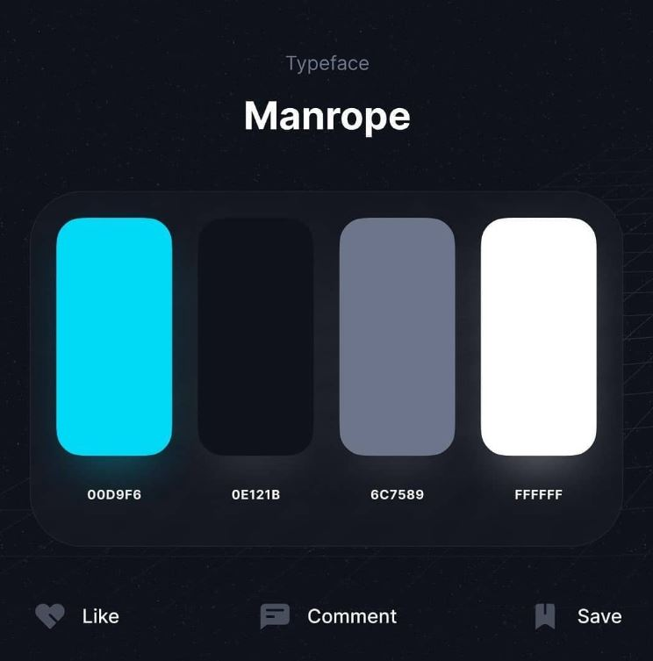

Slide 14
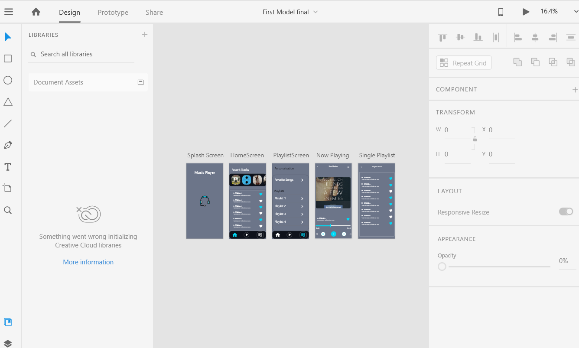
ADOBE XD

Slide 15
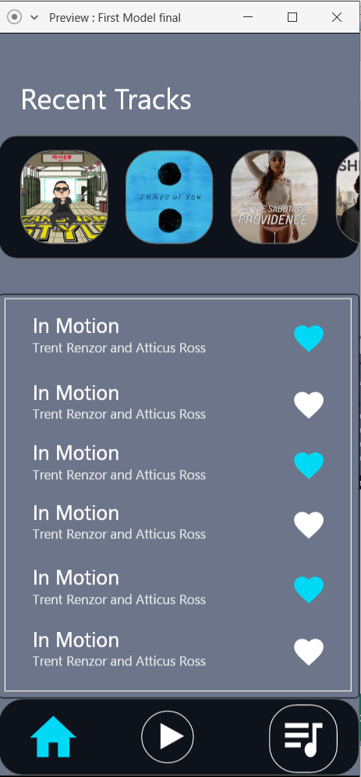
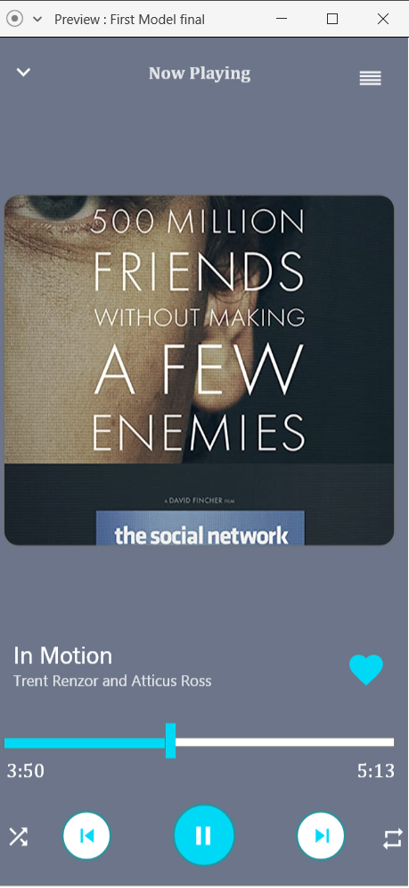
PREVIEW

Slide 16
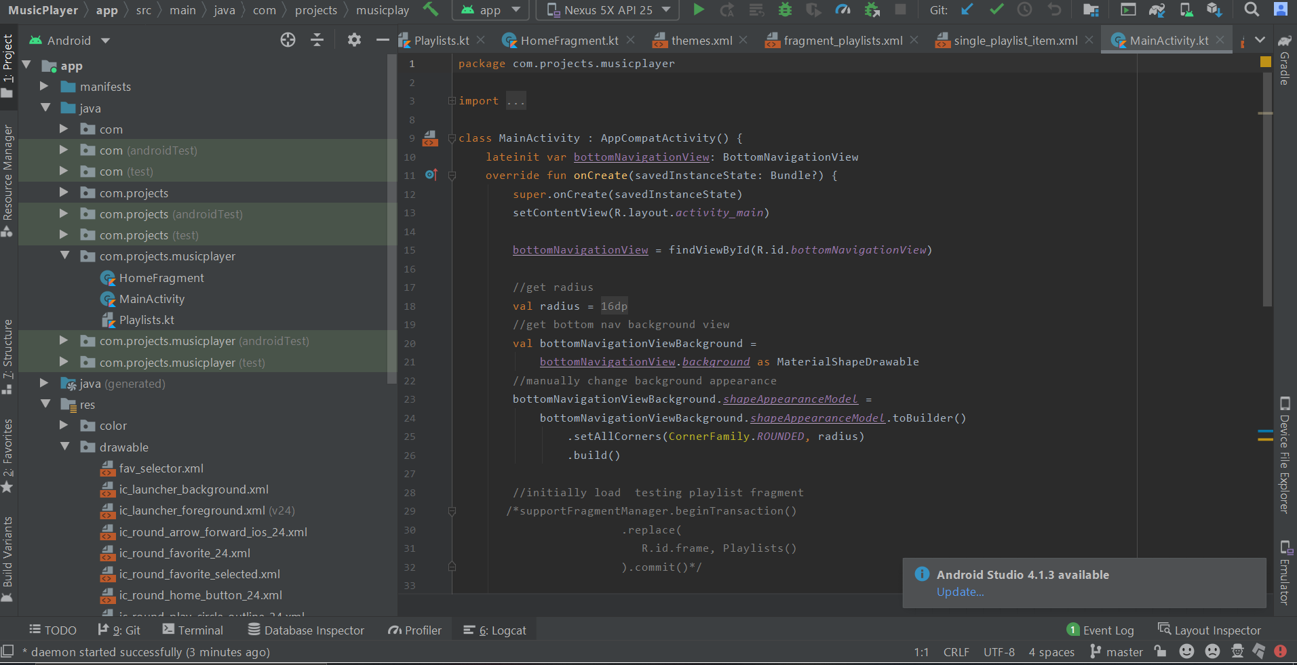
ANDROID STUDIO

Slide 17
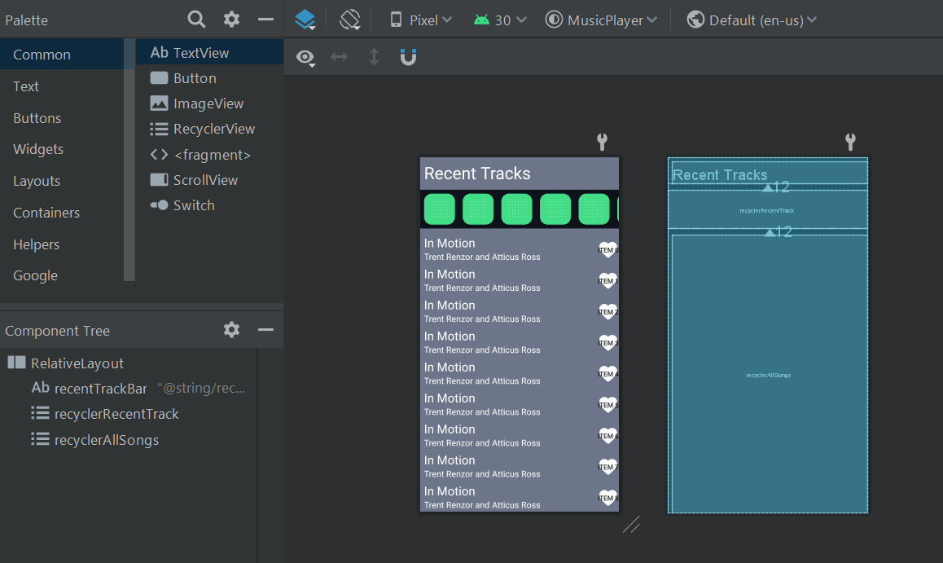
DESIGN IMPLMENTATION

Slide 18
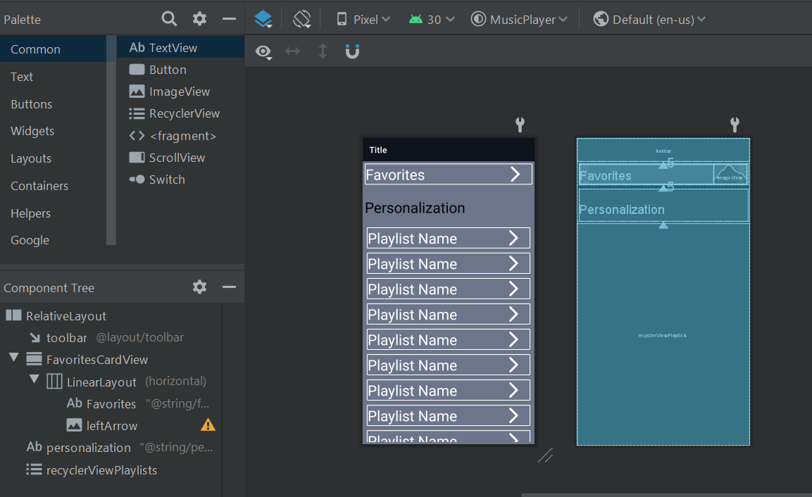

Slide 19
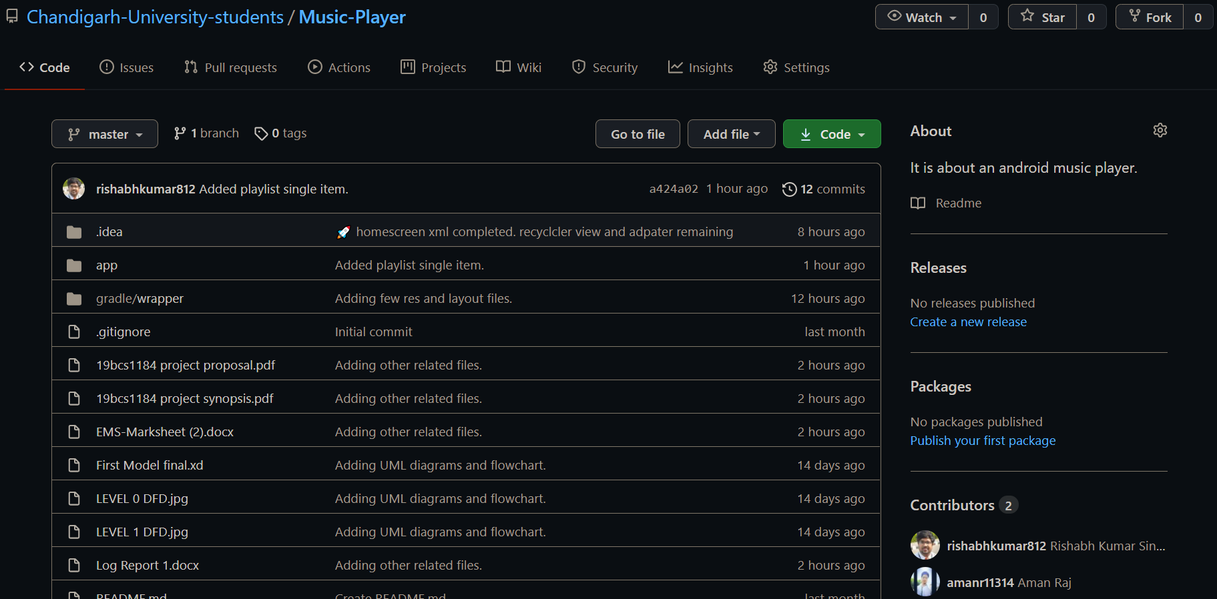
GITHUB REPO

